Slide 1
Chapter-4
Completing the Accounting Cycle

Slide 2
Prepare a worksheet.
Worksheet
  Multiple-column form used in preparing financial statements.
  Not a permanent accounting record.
  May be a computerized worksheet using an electronic spreadsheet program such as Excel.
  Prepared using a five step process.
  Use of worksheet is optional.

Slide 3
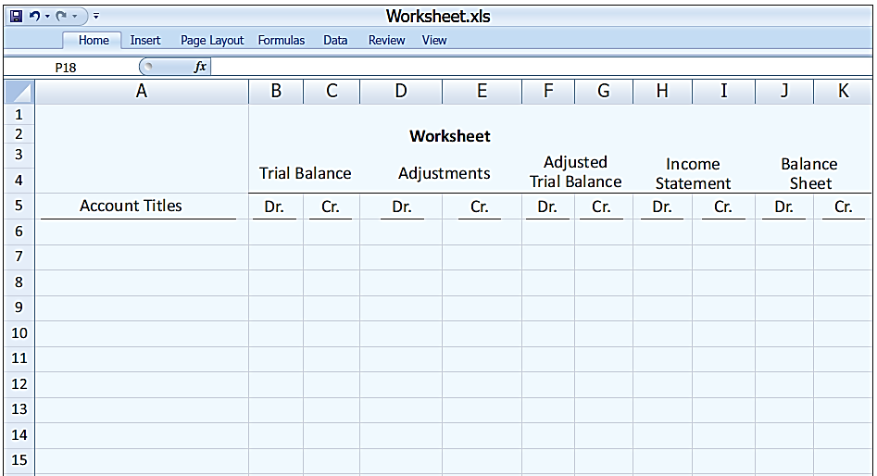
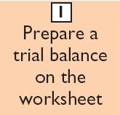
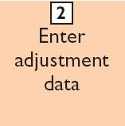
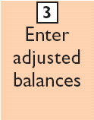
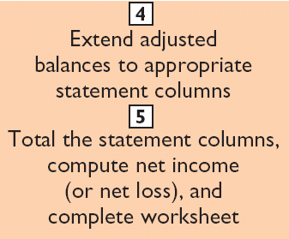
Steps in Preparing a Worksheet
Illustration 4-1

Slide 4
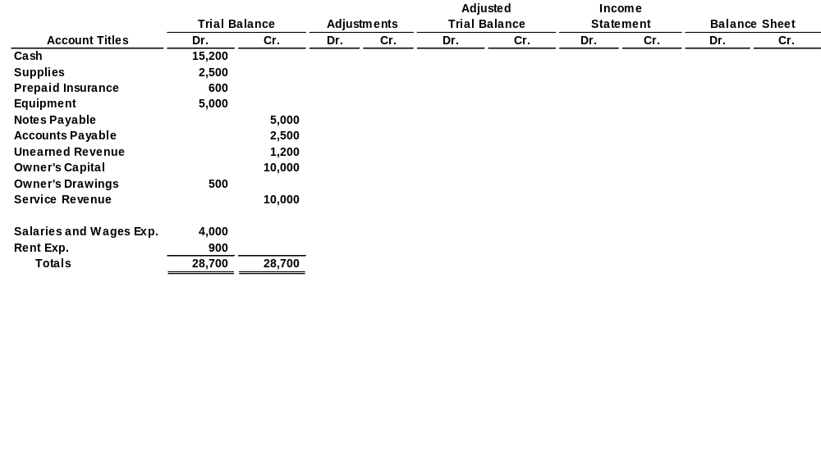
Steps in Preparing a Worksheet
Illustration 4-2
STEP 1: PREPARE A TRIAL BALANCE ON THE WORKSHEET
Trial balance amounts come directly from ledger accounts.
Include all accounts with balances.

Slide 5
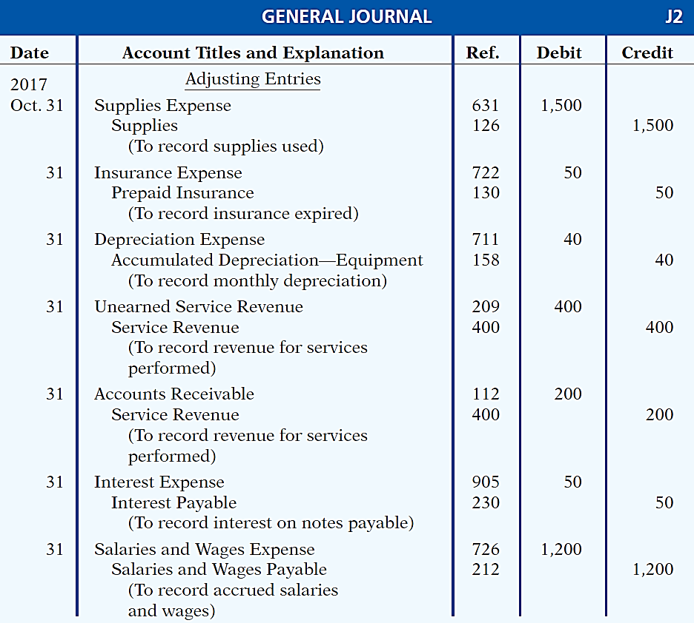
Steps in Preparing a Worksheet
Illustration 3-23
General journal showing adjusting entries
Adjusting Journal Entries
(Chapter 3)

Slide 6
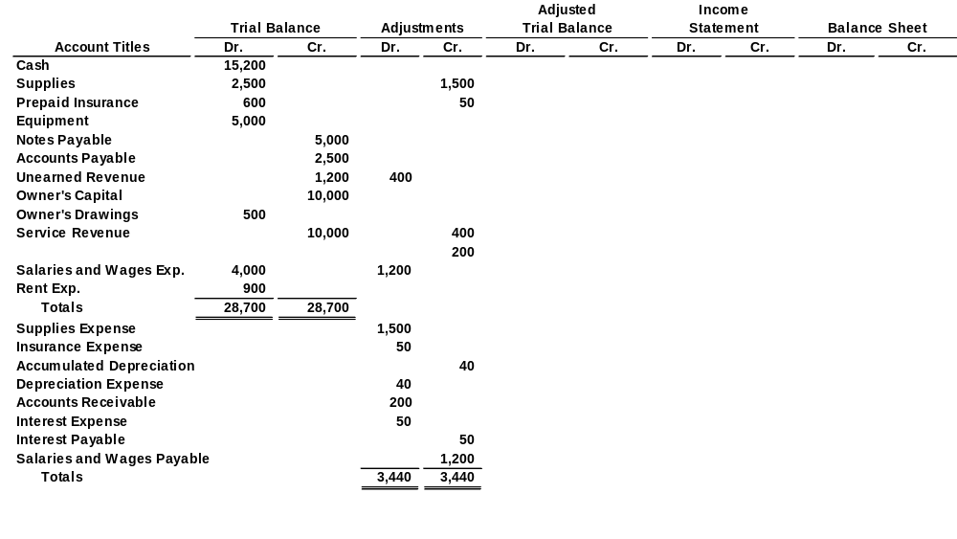
Steps in Preparing a Worksheet
Illustration 4-3
STEP 2: ENTER THE ADJUSTMENTS IN THE ADJUSTMENTS COLUMNS
(a)
(b)
Adjustments Key:
(a) Supplies Used.
(b) Insurance Expired.
(c) Depreciation Expensed.
(d) Service Revenue Recognized.
(e) Service Revenue Accrued.
(f) Interest Accrued.
(g) Salaries Accrued.
(d)
(d)
(e)
(g)
(a)
(b)
(c)
(c)
(e)
Enter adjustment amounts, total adjustments columns,
and check for equality.
(f)
(f)
(g)
Add additional accounts as needed.

Slide 7
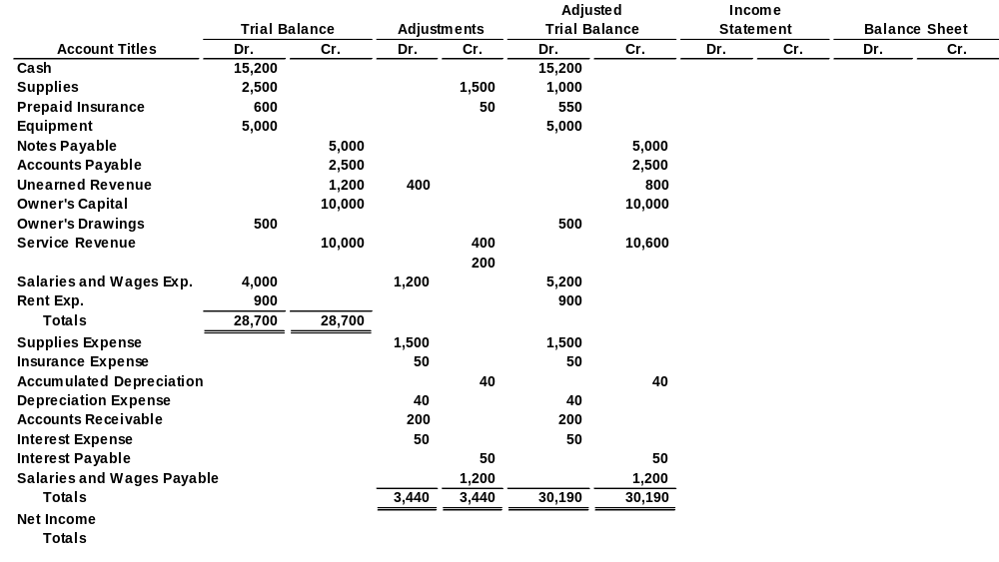
Steps in Preparing a Worksheet
Illustration 4-4
STEP 3: COMPLETE THE ADJUSTED TRIAL BALANCE COLUMNS
(a)
(b)
(d)
(d)
(e)
(g)
(a)
(b)
(c)
(c)
(e)
(f)
(f)
(g)
Total the adjusted trial balance columns and check for equality.

Slide 8
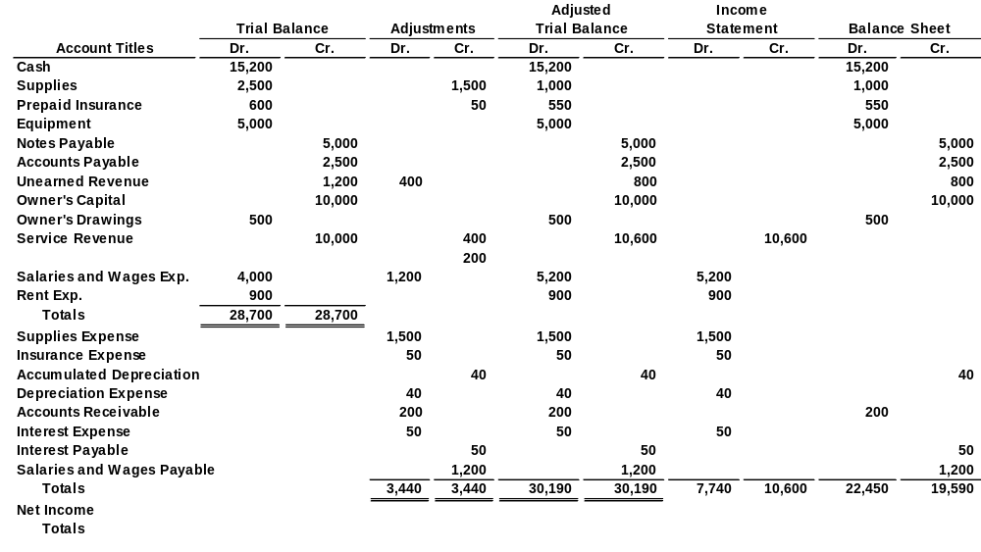
Steps in Preparing a Worksheet
Illustration 4-5
STEP 4: EXTEND AMOUNTS TO FINANCIAL STATEMENT COLUMNS
(a)
(b)
(d)
(d)
(e)
(g)
(a)
(b)
(c)
(c)
(e)
(f)
(f)
(g)
Extend adjusted trial balance amounts to appropriate financial statement columns.

Slide 9
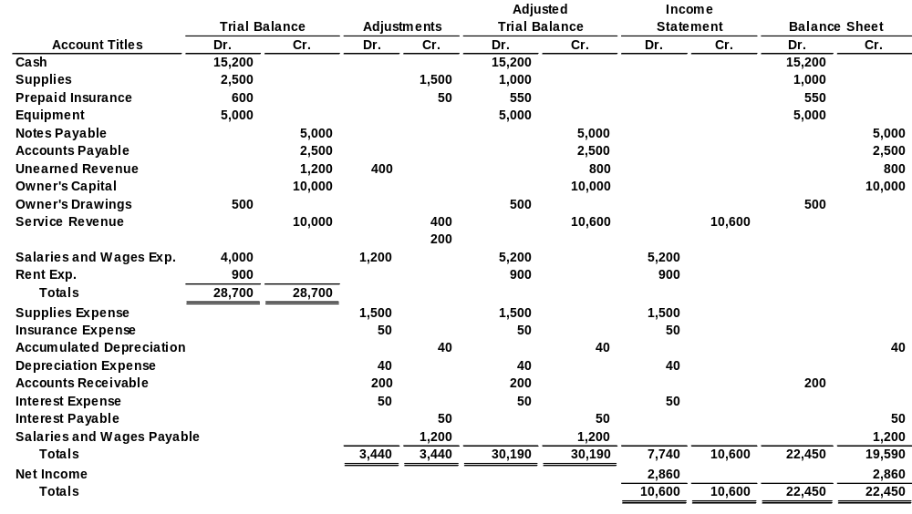
Steps in Preparing a Worksheet
Illustration 4-6
STEP 5: TOTAL COLUMNS, COMPUTE NET INCOME (LOSS)
(a)
(b)
(d)
(d)
(e)
(g)
(a)
(b)
(c)
(c)
(e)
(f)
(f)
(g)
Compute Net Income or Net Loss.

Slide 10
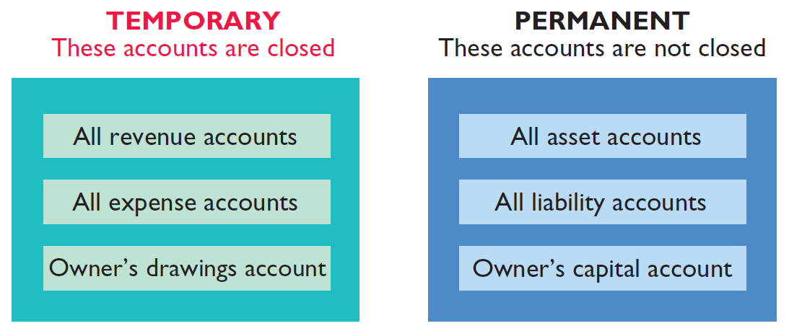
Prepare closing entries and a post-closing trial balance.
At the end of the accounting period, the company makes the accounts ready for the next period.
Illustration 4-8
Temporary versus permanent accounts

Slide 11
Preparing Closing Entries
Closing entries formally recognize in the ledger the transfer of
  net income (or net loss) and
  owner’s drawings
  to owner’s capital.
Companies generally journalize and post closing entries only at the end of the annual accounting period.
Closing entries produce a zero balance in each temporary account.

Slide 12
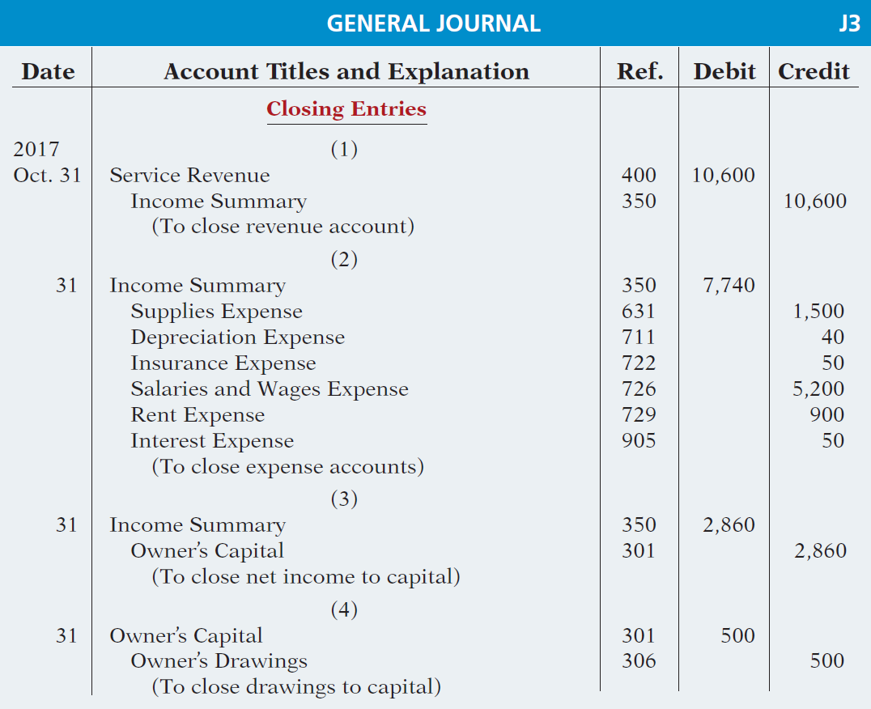
Preparing Closing Entries
CLOSING ENTRIES ILLUSTRATED
Illustration 4-10
Closing entries journalized

Slide 13
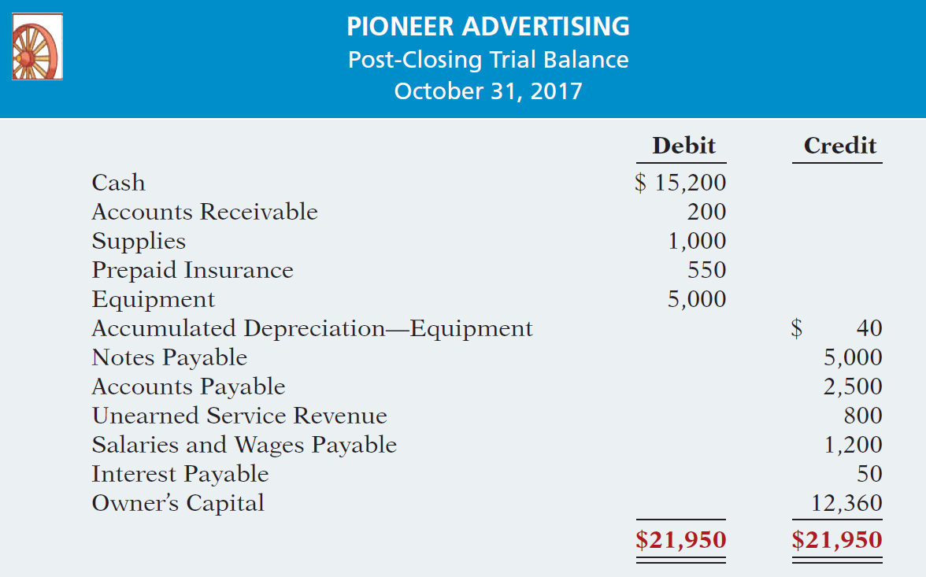
Preparing a Post-Closing Trial Balance
Purpose is to prove the equality of the permanent account balances carried forward into the next accounting period.
Illustration 4-12
Post-closing trial balance

Slide 14
Explain the steps in the accounting cycle and how to prepare correcting entries.
Illustration 4-15
1. Analyze business transactions
9. Prepare a post-closing trial balance
2. Journalize the transactions
8. Journalize and post closing entries
3. Post to ledger accounts
7. Prepare financial statements
4. Prepare a trial balance
6. Prepare an adjusted trial balance
5. Journalize and post adjusting entries

Slide 15
Correcting Entries—An Avoidable Step
  Unnecessary if accounting records are free of errors.
  Made whenever an error is discovered.
  Must be posted before closing entries.
Instead of preparing a correcting entry, it is possible to reverse the incorrect entry and then prepare the correct entry.

Slide 16
Correcting Entries—An Avoidable Step
CASE 1: On May 10, Mercato Co. journalized and posted a $50 cash collection on account from a customer as a debit to Cash $50 and a credit to Service Revenue $50. The company discovered the error on May 20, when the customer paid the remaining balance in full.
Incorrect entry
Cash 50
Service Revenue 50
Correct entry
Cash 50
Accounts Receivable 50
Correcting entry
Service Revenue 50
Accounts Receivable 50

Slide 17
Correcting Entries—An Avoidable Step
CASE 2: On May 18, Mercato purchased on account equipment costing $450. The transaction was journalized and posted as a debit to Equipment $45 and a credit to Accounts Payable $45. The error was discovered on June 3.
Incorrect entry
Equipment 45
Accounts Payable 45
Correct entry
Equipment 450
Accounts Payable 450
Correcting entry
Equipment 405
Accounts Payable 405

Slide 18
DO IT!
3
Correcting Entries
Sanchez Company discovered the following errors made in January 2017 .
A payment of Salaries and Wages Expense of $600 was debited to Supplies and credited to Cash, both for $600.
A collection of $3,000 from a client on account was debited to Cash $200 and credited to Service Revenue $200.
The purchase of supplies on account for $860 was debited to Supplies $680 and credited to Accounts Payable $680.
Correct the errors without reversing the incorrect entry.

Slide 19
Identify the sections of a classified balance sheet.
  Presents a snapshot at a point in time.
  To improve understanding, companies group similar assets and similar liabilities together.
Standard Classifications
Illustration 4-20
Assets Liabilities and Owner’s Equity
Current assets Current liabilities
Long-term investments Long-term liabilities
Property, plant, and equipment Owner’s (Stockholders’) equity
Intangible assets

Slide 20
Current Assets
  Assets that a company expects to convert to cash or use up within one year or the operating cycle, whichever is longer.
  Operating cycle is the average time that it takes to purchase inventory, sell it on account, and then collect cash from customers.

Slide 21
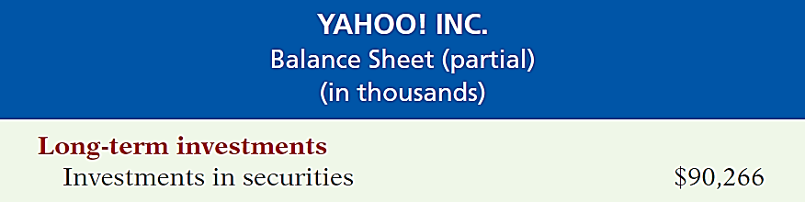

Long-Term Investments
  Investments in stocks and bonds of other companies.
  Investments in long-term assets such as land or buildings that is not currently being used in operating activities.
  Long-term notes receivable.
Illustration 4-23

Slide 22
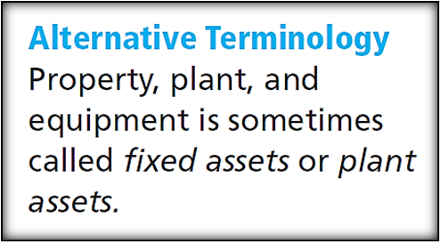
Property, Plant, and Equipment
  Long useful lives.
  Currently used in operations.
  Depreciation - allocating the cost of assets to a number of years.
  Accumulated depreciation - total amount of depreciation expensed thus far in the asset’s life.

Slide 23
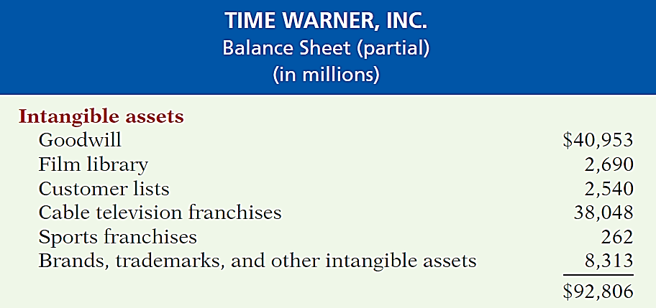

Intangible Assets
  Long-lived assets that do not have physical substance.
Illustration 4-25

Slide 24
Current Liabilities
  Obligations the company is to pay within the coming year or its operating cycle, whichever is longer.
  Usually list notes payable first, followed by accounts payable. Other items follow in order of magnitude.
  Common examples are accounts payable, salaries and wages payable, notes payable, interest payable, income taxes payable current maturities of long-term obligations.
  Liquidity - ability to pay obligations expected to be due within the next year.
LO 4

Slide 25
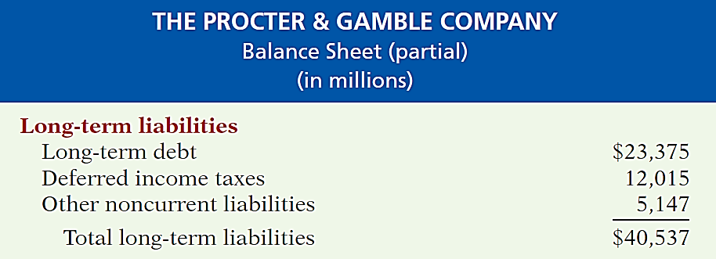
Long-Term Liabilities
  Obligations a company expects to pay after one year.
Illustration 4-27
LO 4

Slide 26
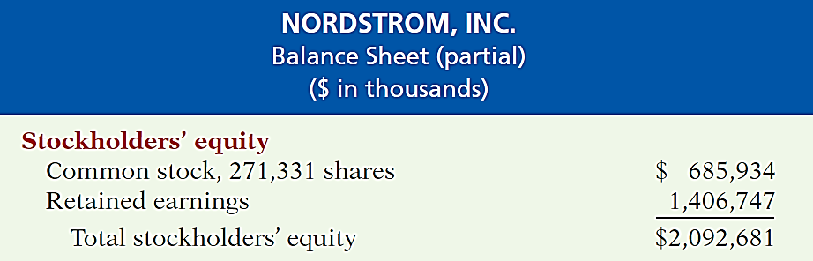
Owner’s Equity
  Proprietorship - one capital account.
  Partnership - capital account for each partner.
  Corporation - Common Stock and Retained Earnings.
Illustration 4-28
LO 4

Slide 27
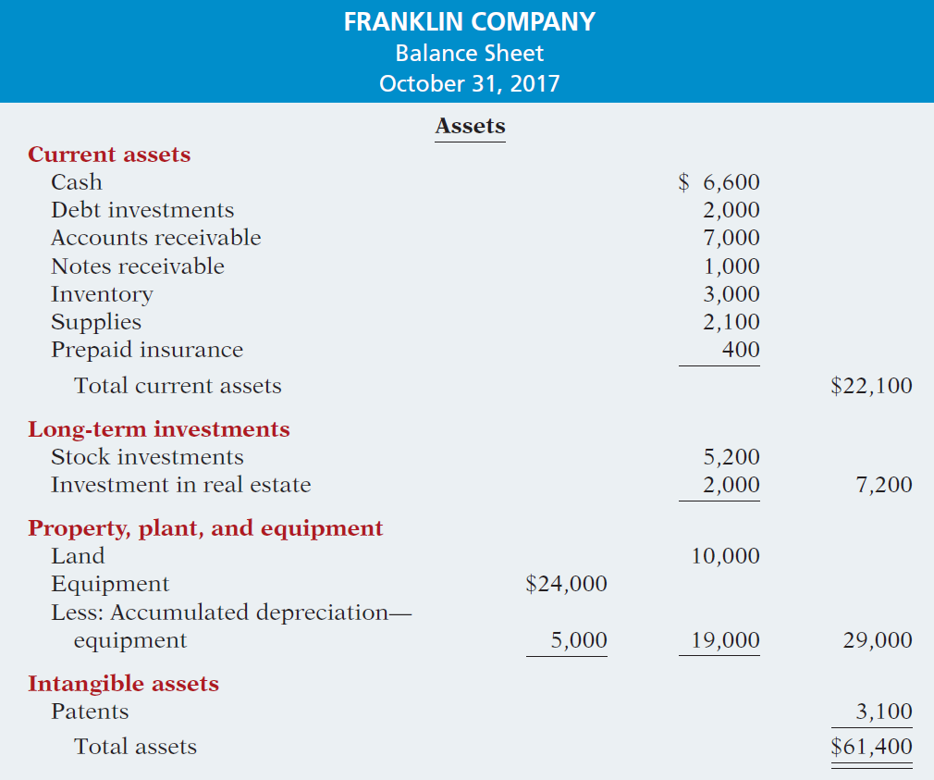
The Classified Balance Sheet
Illustration 4-21
LO 4

Slide 28
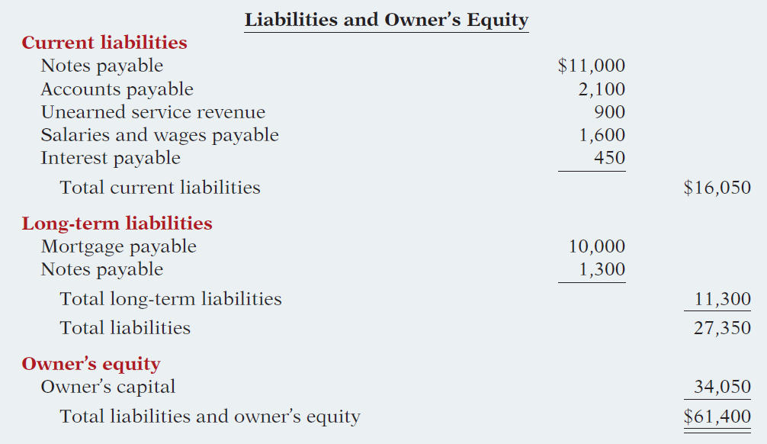
The Classified Balance Sheet
Illustration 4-21
LO 4

